Slide 1
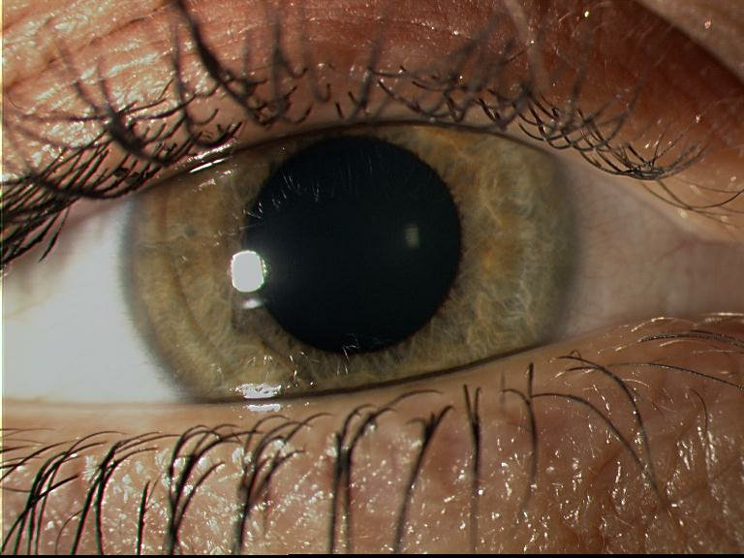
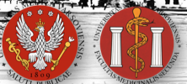
Extensive Orbital Soft Tissues Reconstruction and Lids Reconstructive Surgery in Patient after Orbital Rhabdomyosarcoma Treatment - Case Report
Magdalena Korwin, Anna Kamińska, Małgorzata Sybilska, Jerzy Szaflik
Department of Ophthalmology
Medical University of Warsaw, Warsaw, Poland
Head: prof. Jacek P. Szaflik

Slide 2

Aim
The aim of the paper is to present results of extensive orbital soft tissue reconstruction along with forinces reconstruction in female patient after radio- and supplementary chemiotherapy due to rhabdomyosarcoma.
Materia and Methods
30-years old female patient referred to our Department for right orbit reconstruction.
When she was 3 right rhabdomyosarcoma was diagnosed. Patient underwent complete oncological therapy with eyeball sparing. Complete radiotherapy and chemotherapy with vincristine, actinomycine and adriblastine was performed.
Oncological clearance was achieved.
Simultaneously late local post-radiotherapy complications occurred in a form of lagophthalmos, corneal llimbus deficiency, secondary glaucoma, orbital tissues atrophy and facial bones undergrowth.
Patient was qualified for enucleation with orbital implant implantation, lipo-transfer and reconstructive surgery of forinces.

Slide 3
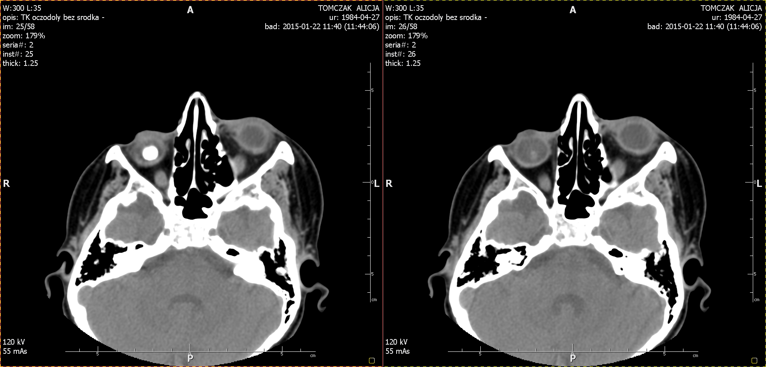
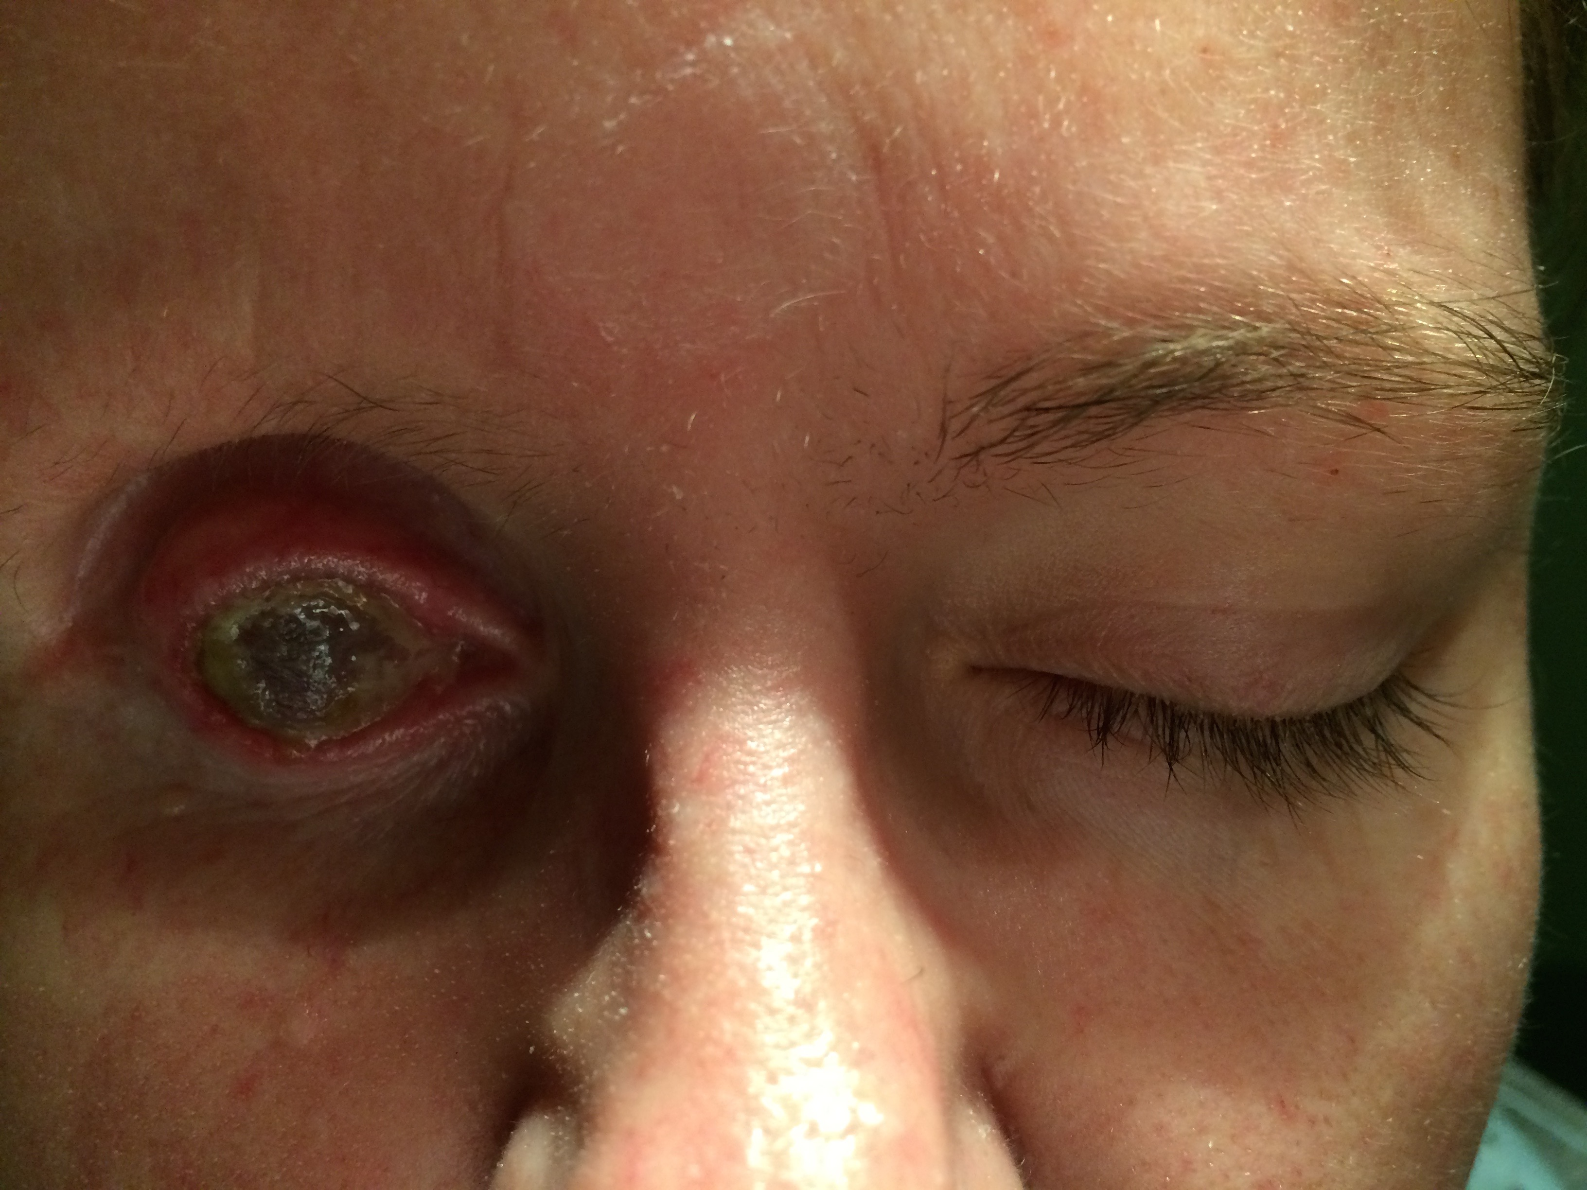
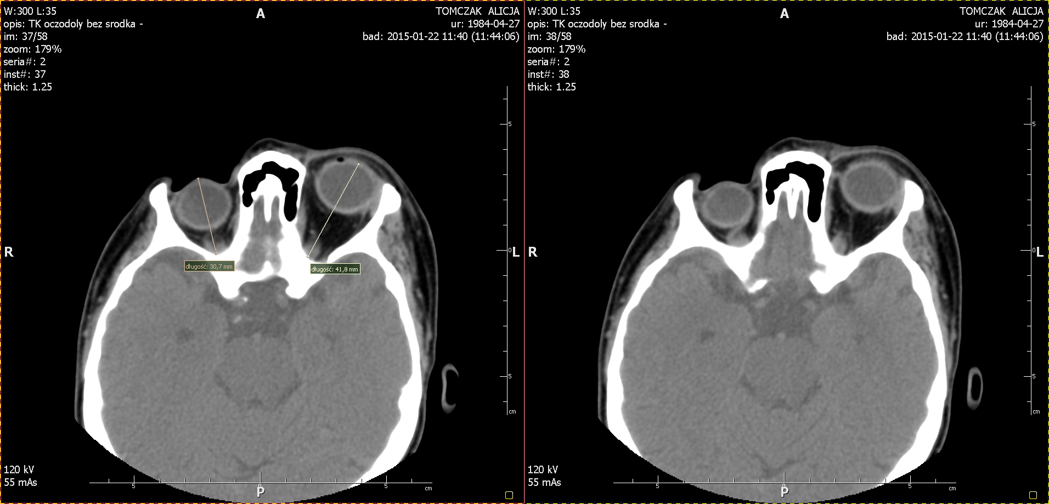
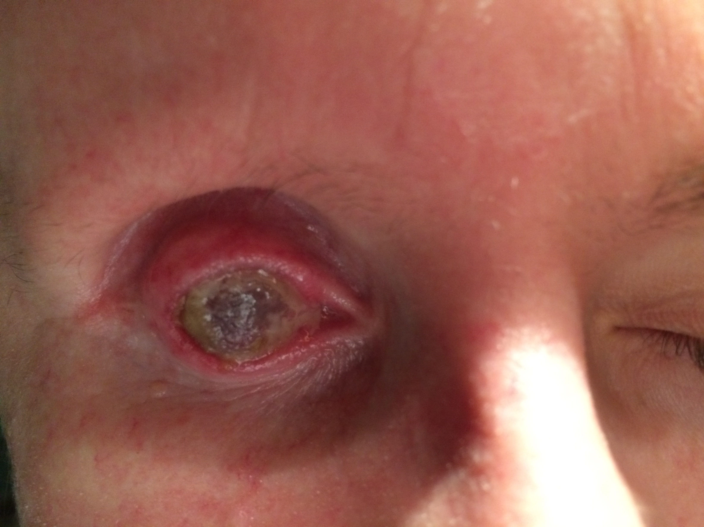
MRI images of the orbits and face photos before surgery

Slide 4
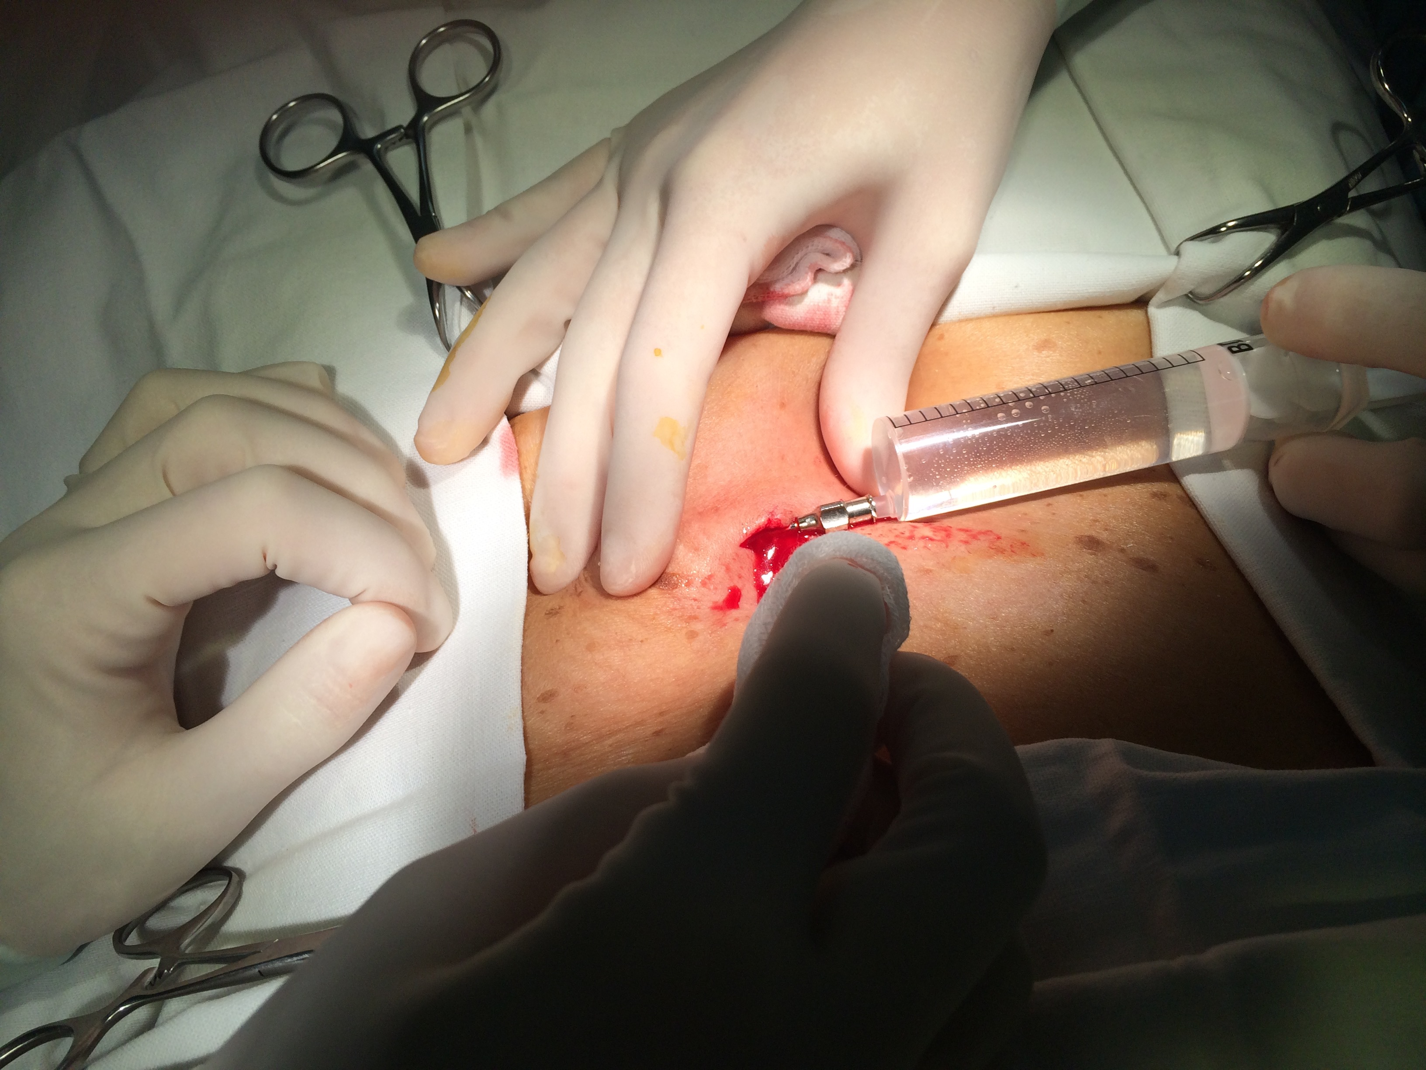
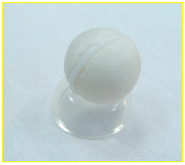
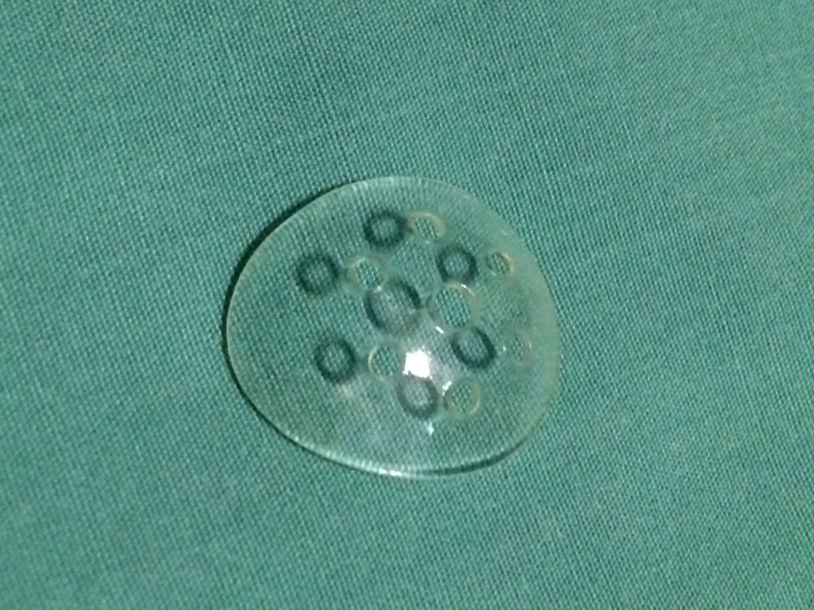
Lipo-transfer
Bioceramic orbital implant ready for implantation
Rigid conformer placed into fornices

Slide 5
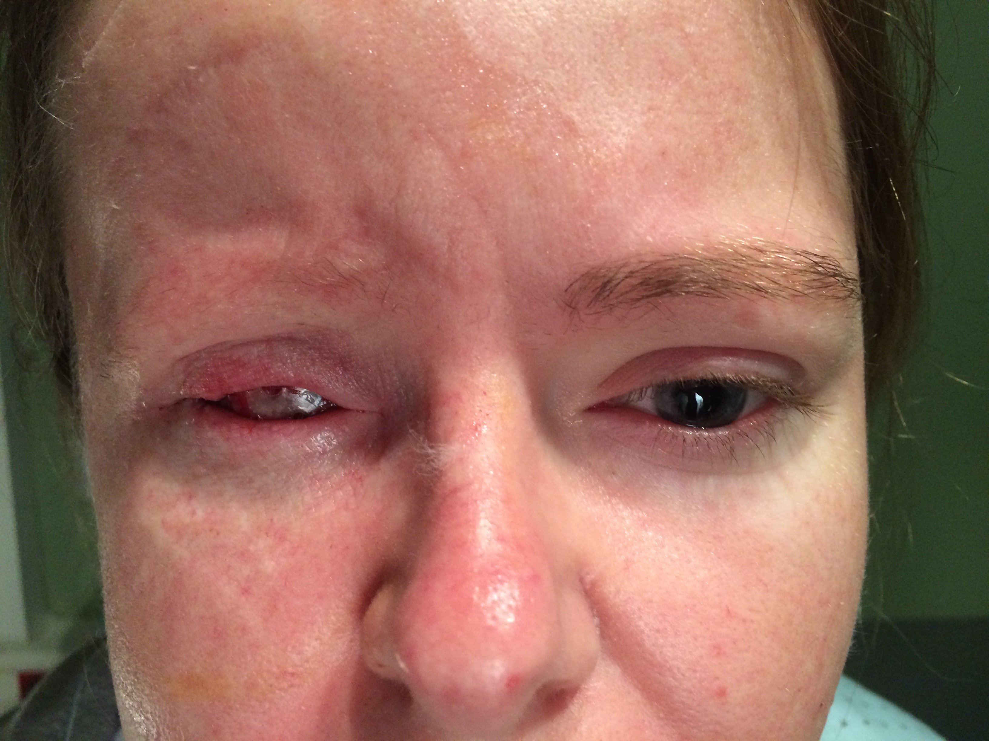
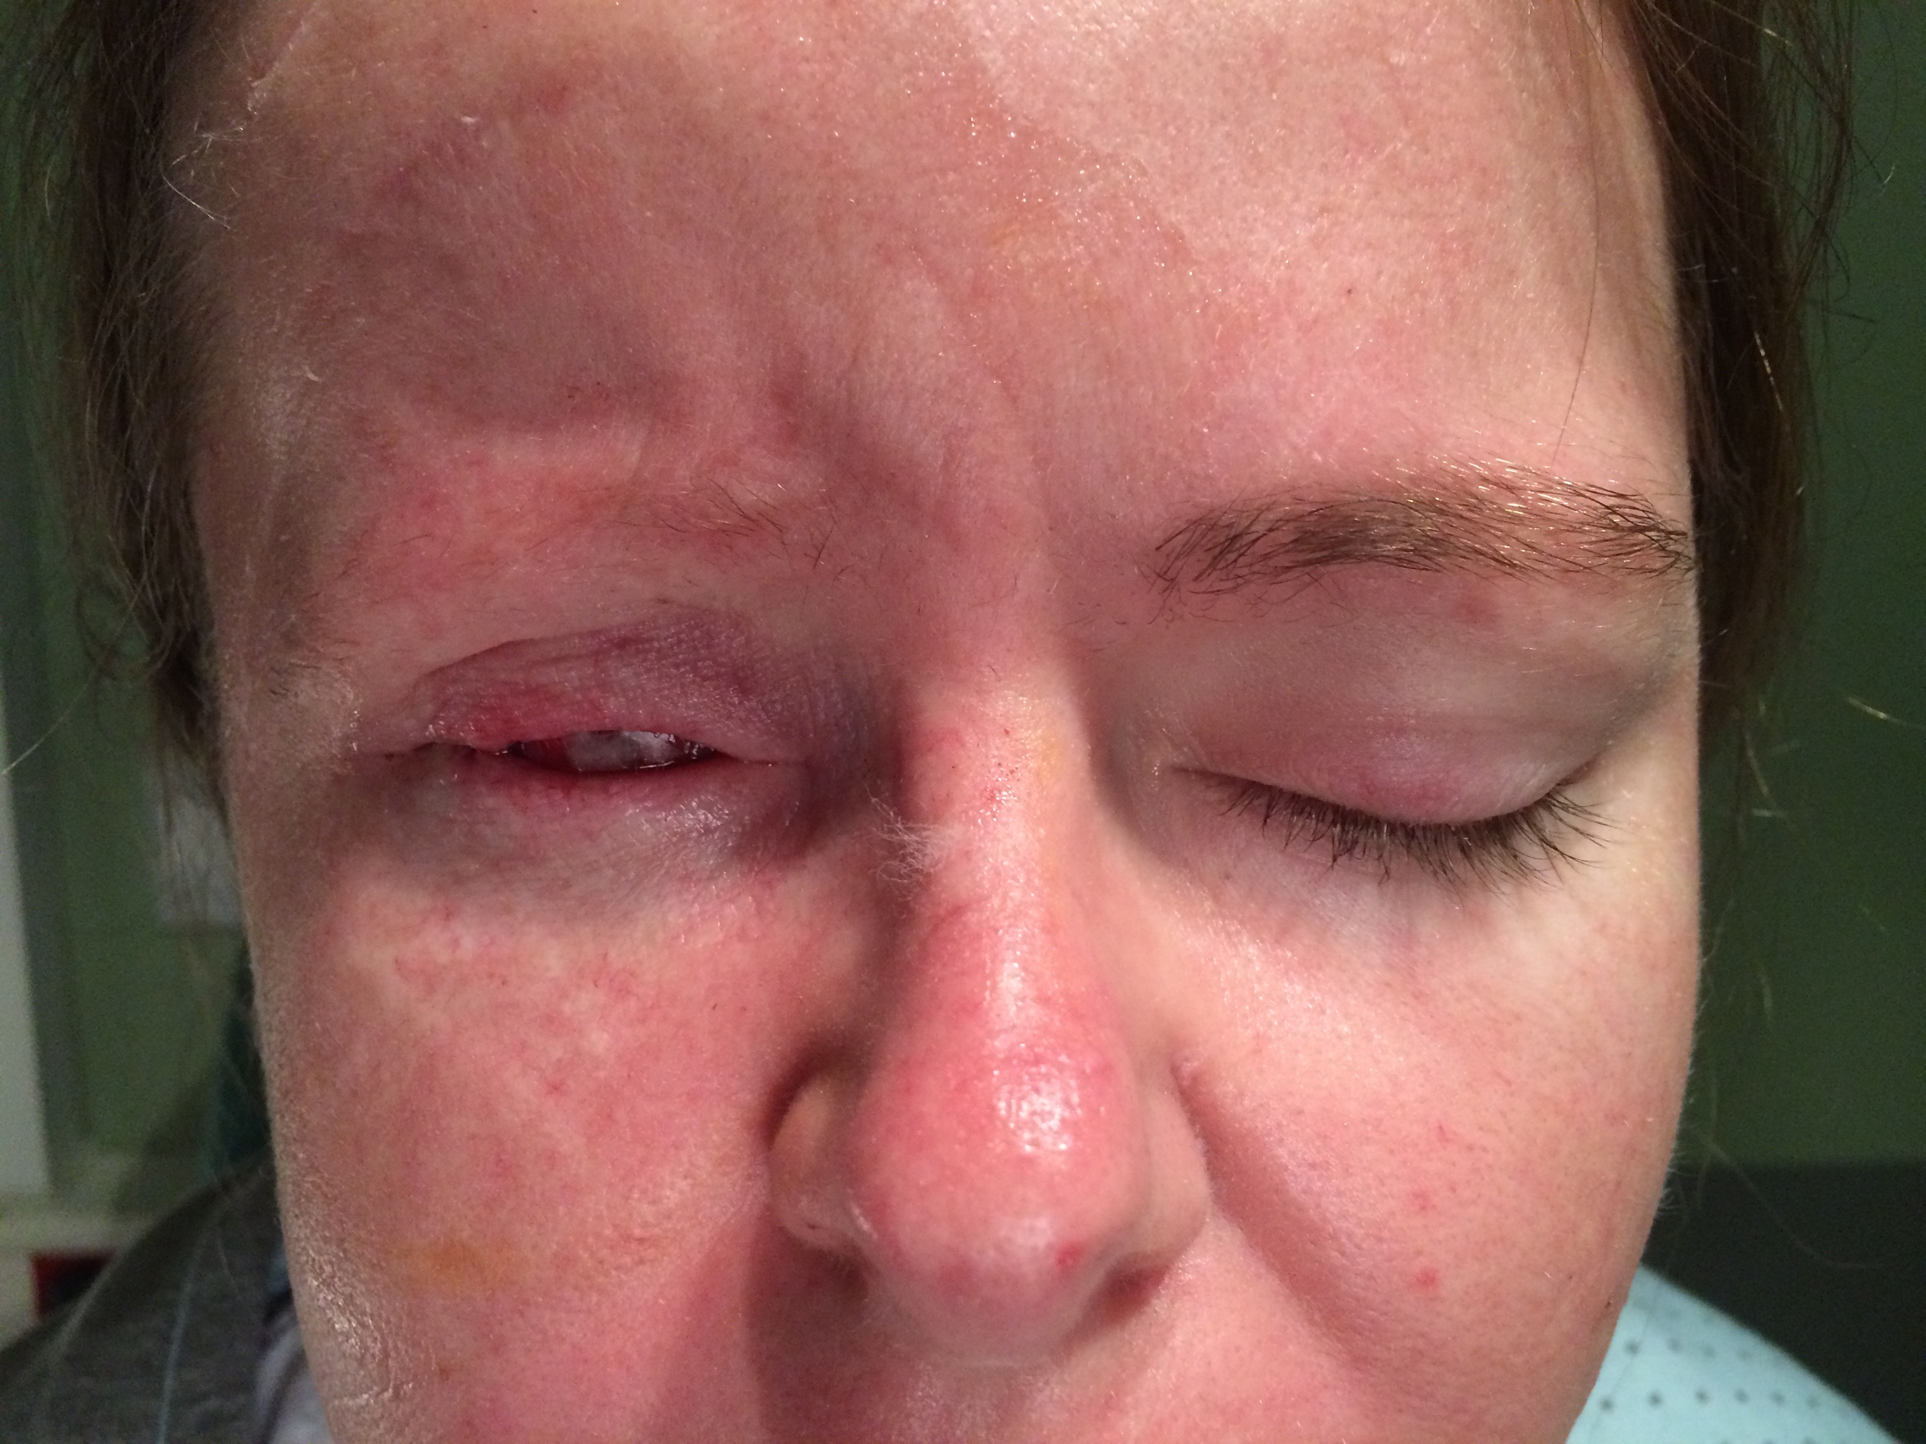
Results
Surgery was uneventful. Adipose tissue transfer was performed from periumbilical area. Fornices were reconstructed. Additionally eyelid spacers were used to increase vertical eyelids height. We were able to achieve satisfactory functional and cosmetic outcome.
Currently, patient is qualified for eye-lashes and eye-brow hair transplantation as a final stage of complele reconstruction.

Slide 6
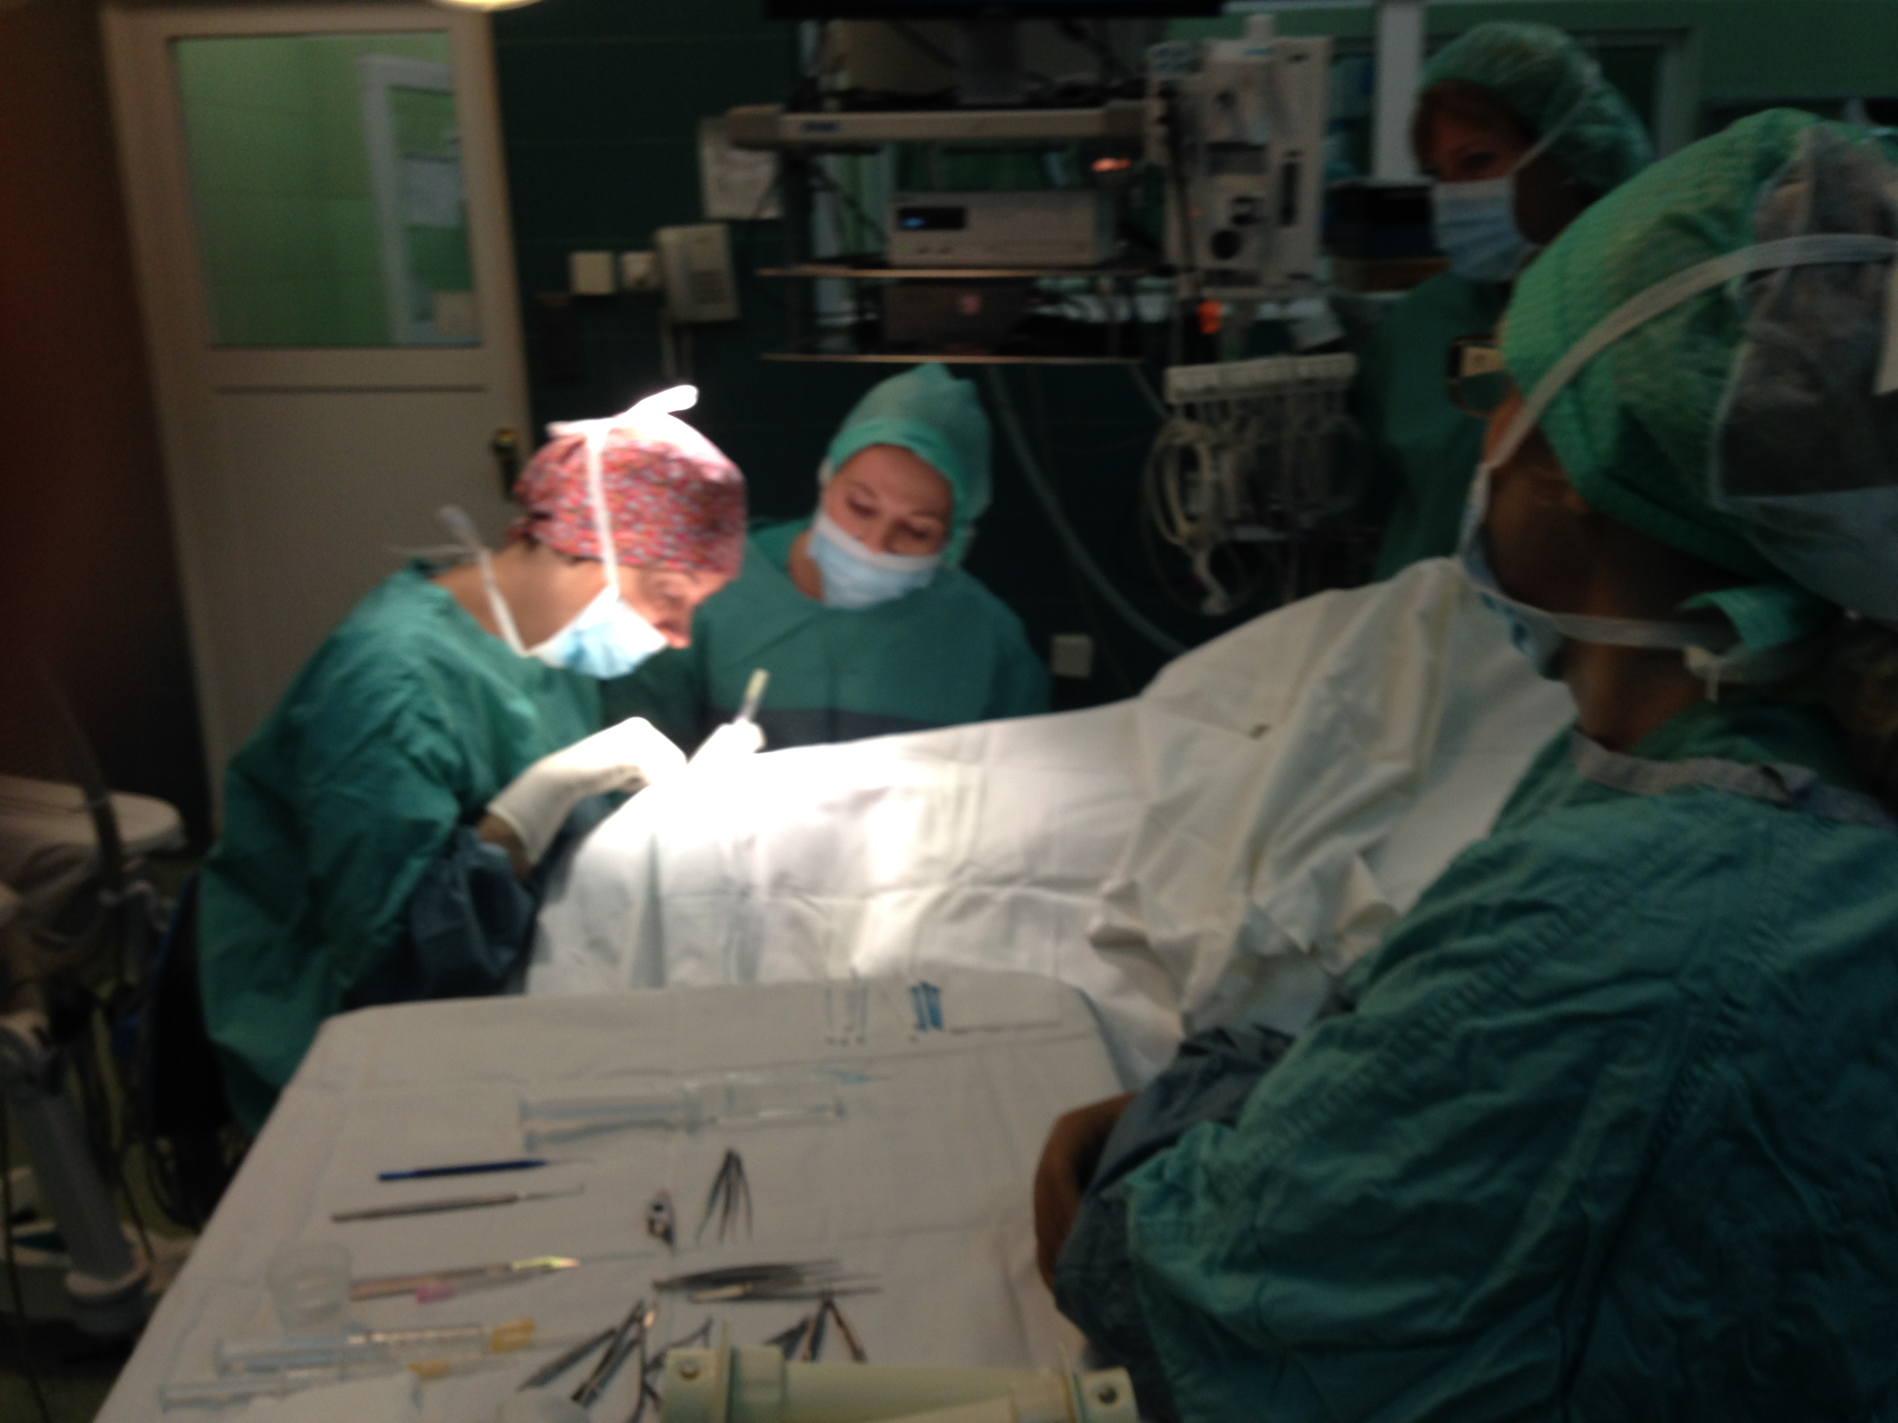
Conclusions
Orbital soft tissue reconstruction and eye-lids reconstructive surgery in patients after rariotherapy are extremely challenging for oculoplastic surgeon. Additionally, due to huge progress in plastic and reconstructive surgery the local and general cosmetic appearance is possible, which also significantly improves theit quality of life and self-esteem.

